Slide 1
Paper - Traumatic Brain Injury Detection Using Electrophysiological Methods
By: Steven Cao

Slide 2
What is mTBI?
Definition
Mild traumatic brain injury (mTBI), or concussion, is the most common type of traumatic brain injury. With mTBI comes symptoms that include headaches, fatigue, depression, anxiety and irritability, as well as impaired cognitive function.
How it is caused?
A traumatic brain injury (TBI) occurs from sudden trauma which causes damage to the brain. TBI can happen when the head suddenly and violently hits an object or when an object pierces the skull and enters brain tissue.
Symptoms
Symptoms may include headache, confusion, lack of coordination, memory loss, nausea, vomiting, dizziness, ringing in the ears, sleepiness, and excessive fatigue.

Slide 3
how much of an issue is mTBI?
Over75%of the 266,000 brain injuries reported during U.S. military operations from 2000 to 2012 were classified as mTBI, thus underscoring mTBI as a major health issue in the U.S. military (Hoge et al., 2008).
The long-term effects of mTBI
The effects of TBI can be significant and long-lasting. Fazel et al. (2014) compared mortality rates 6months or more after injury against a control population. They found that TBI is associated with substantially elevated risks of premature mortality, particularly from suicide, injuries, and assaults. Similarly, TBI is a significant risk factor for neuropsychiatric disorders (Rapp et al., 2013a).

Slide 4
About the qEEG method
What is it?
Quantitative electroencephalography (QEEG) is a modern type of electroencephalography (EEG) analysis that involves recording digital EEG signals which are processed, transformed, and analyzed using complex mathematical algorithms.
Also called “brain mapping,” qEEG is a type of test that measures the electrical activity in the brain. In simple terms, the test measures brain waves the same way an electrocardiogram, or EKG, measures the heart's electrical activity.
How it works?
QEEG is noninvasive, painless, and safe to use. The electrodes in the cap that are placed on the scalp are like a “read-only” program that receives signals from the brain. The electrodes do not alter brain activity in any way; they simply reveal areas where brain wave activity is healthy, underactive, or overactive.

Slide 5
Interpretations on qEEG for detecting mTBI after reading paper
TBI is not a discrete (individually separate and distinct) clinical entity (concept used to define the nature of a disorder in order to facilitate diagnosis and intervention). Different injury events can initiate very different pathophysiological (the disordered physiological processes associated with disease or injury.) processes. It follows that, just as there is not a single test for cancer, there is not a single test for TBI.
qEEG measures are unlikely to discriminate (differentiate) between, for example, major depressive disorder, bipolar disorder, or TBI. The specificities observed in these clinical studies may well be lost in real world clinical practice.
In order to get the desired result in detecting mTBI, it requires acceptable test–retest reliability. To date, very few test–retest reliability studies have been published with qEEG data obtained from TBI patients. This is a particular concern because high variability is a known characteristic of the injured CNS.

Slide 6
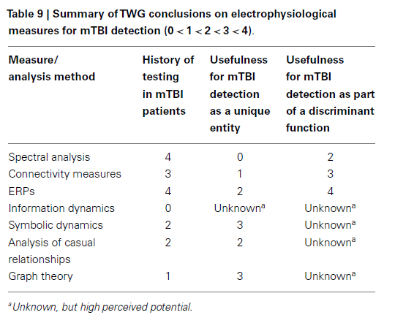
How

